Slide 1
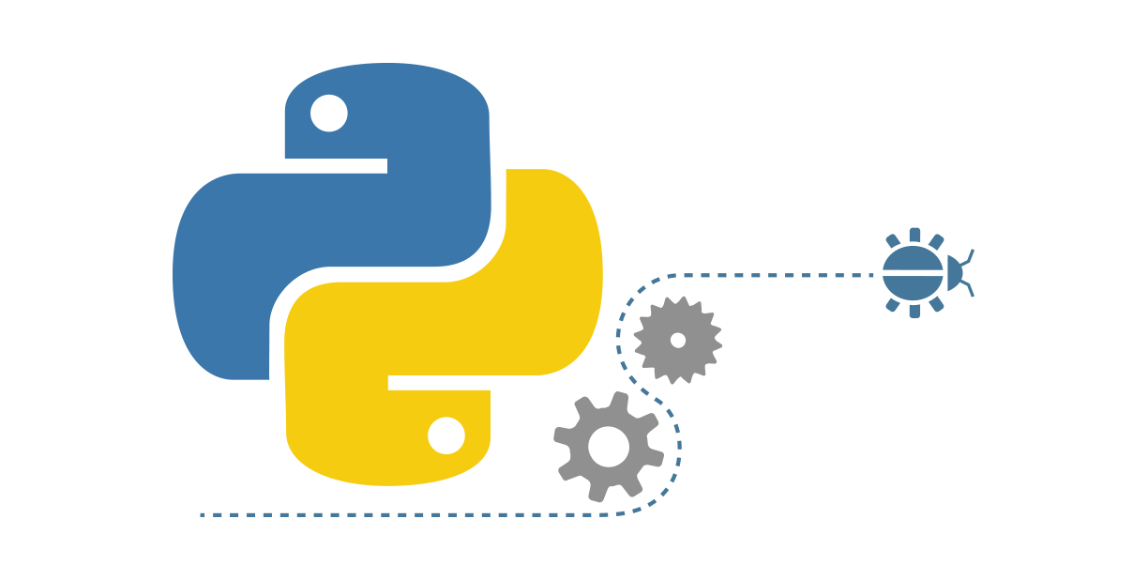
PYTHON
Presented By:
Mohit Chandra Bhatt
BTECH CSE 4th Year
AITS, Haldwani
160030101029
INDUSTRIAL TRAINING REPORT
CEBS Worldwide
CEBS Worldwide

Slide 2
About the CEBS Worldwide
It is a global IT company dedicated to providing E-Business solutions to worldwide customers.
Retail, BFSI, Airlines, Manufacturing, Telecom and Government.
It offer solutions and services in the area of Software Product Engineering, Customer Experience Management, Digital Analytics, B2B Integration, Marketing Campaign Automation and many more.

Slide 3
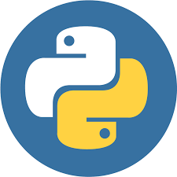
Overview
Introduction to Python Language.
Python Overview
Python Features
Uses of Python
Standard Data Types
Python GUI
Project

Slide 4

Introduction to Python3.7
Python is Object Oriented Programming Language.
It is free and open source Language.
Python is a general-purpose, high-level, interpreted and object oriented-scripting language.
It is cross platform – runs on multiple platforms
Python Language is of two types –
Python 2
Python 3

Slide 5
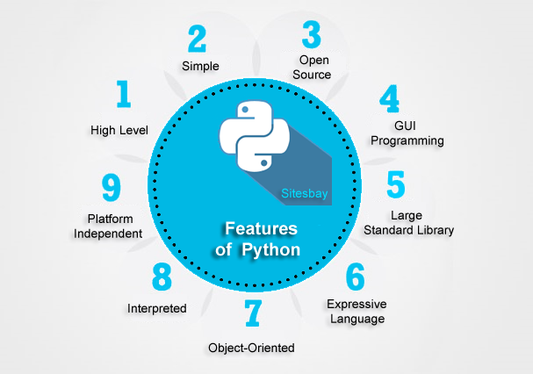
Python Features
Easy to Learn and Use
Expressive Language
Interpreted Language
Cross-Platform Language
Free and Open Source
Object Oriented Language
Extensible
Large Standard Library
GUI programming Support

Slide 6
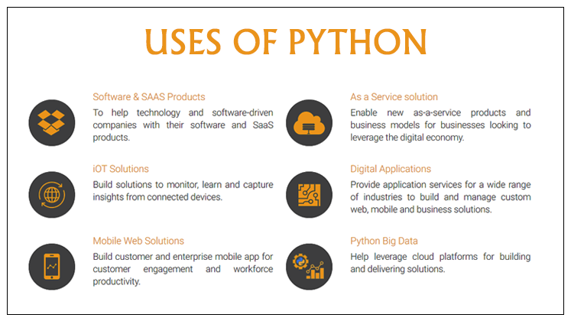
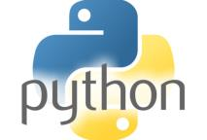
Portable: Python can run on a wide variety of hardware platforms and has the same interface on all platforms.
Extendable: You can add low-level modules to the Python interpreter. These modules enable programmers to add to or customize their tools to be more efficient.
Databases: Python provides interfaces to all major commercial databases.
GUI Programming: Python supports GUI applications that can be created and ported to many system calls, libraries, and windows systems, such as Windows MFC, Macintosh, and the X Window system of Unix.
Scalable: Python provides a better structure and support for large programs than shell scripting.

Slide 7
Standard Data Types
Numbers : a = 10
String : str = ‘Hello World’
Tuple : t = ("hi", "python", 2)
List : list = [123, ‘hello’, 12, 1.3]
Set : fruit = {apple, orange, grapes, mango}
Dictionary : stu = {‘name’ : ‘red’ , ‘age’ : 10}

Slide 8
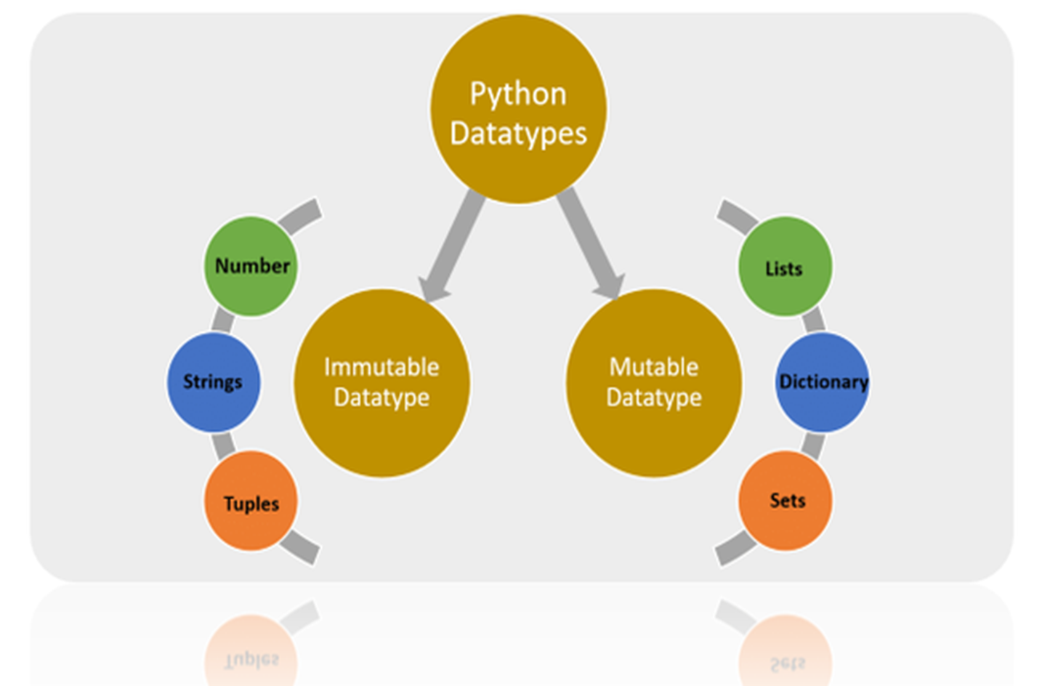
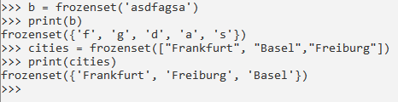
2. Frozen Sets - Immutable and new elements cannot added after its deﬁned.

Slide 9
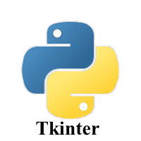
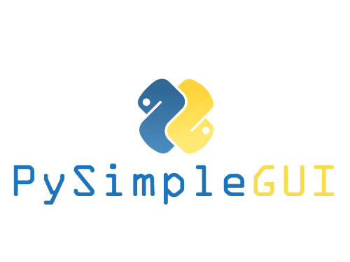
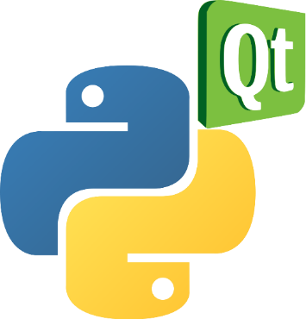
GUI in Python
1. Tkinter
2. PyQt Designer

Slide 10
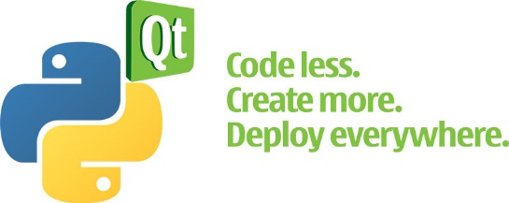
Qt Framework
Qt Designer is the Qt tool for designing and building GUI graphical user interfaces.
It allows you to design
widgets
dialogs
complete main windows
using on-screen forms and a simple drag-and-drop interface.

Slide 11

PyQt
PyQt is a Python binding of the cross-platform GUI toolkit Qt, implemented as a Python plug-in.
PyQt is free software developed by the British firm Riverbank Computing.
PyQt implements around 440 classes and over 6,000 functions and methods
Important modules in PyQt5 :
QtGui, QtCore, QtWidgets, QtWebkit , QtWebkitWidgets

Slide 12
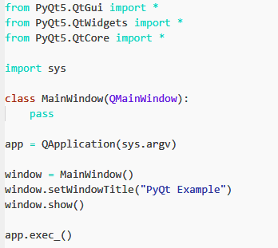
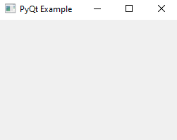
Example :
Code
Output

Slide 13
PROJECT
Client Server Application

Slide 14
About the Project
The main objective is to carry out the chatting process among n-clients.
Incorporates 1 server – multiple Client format.
Concept of socket programming is used to establish a connection between client and server.
Programming Language – Python3
GUI – Tkinter and PyQt
Database - MySql

Slide 15
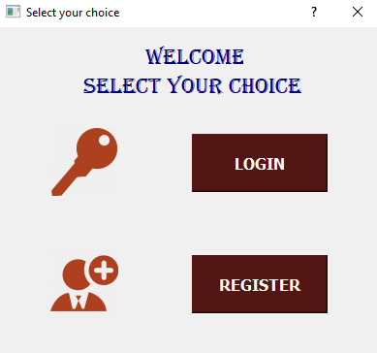

Slide 16
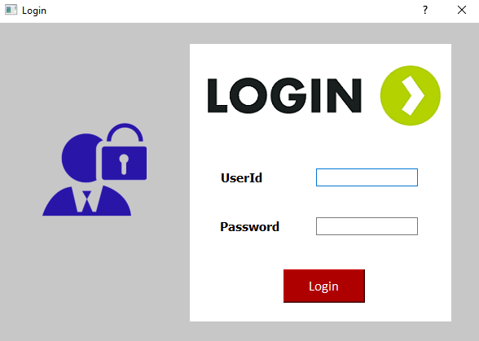
Login Window

Slide 17
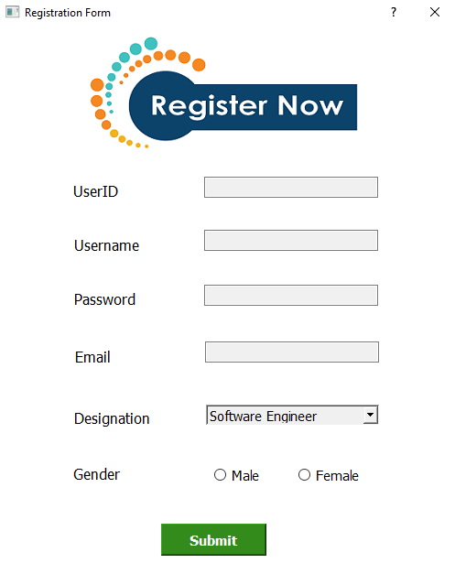
User Registration

Slide 18
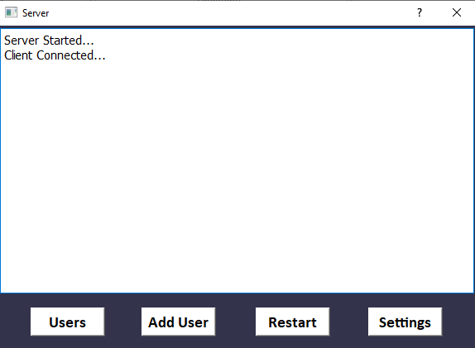
Server

Slide 19
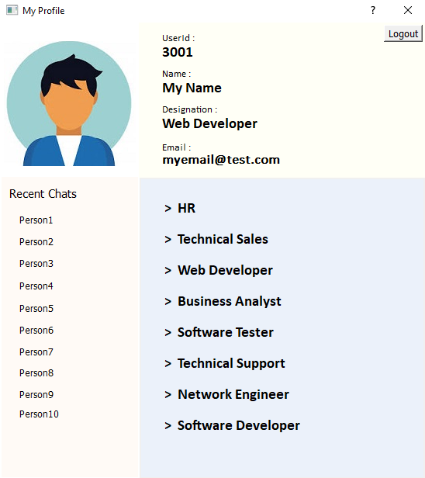
Client Portal

Slide 20
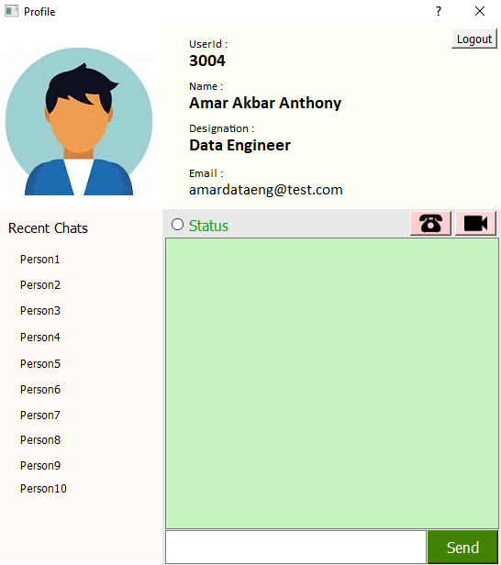
Chatting Window

Slide 21
THANK YOU

